Slide 1
Team CodeToConnect
Contacts And Networking Application

Slide 2
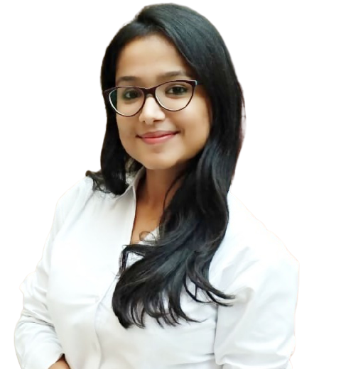
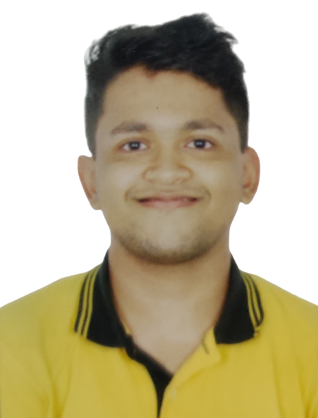
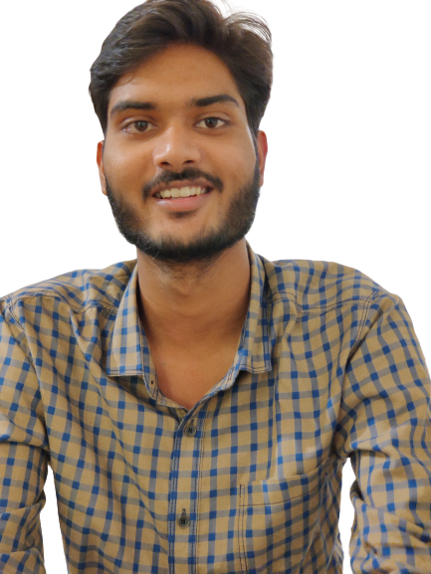
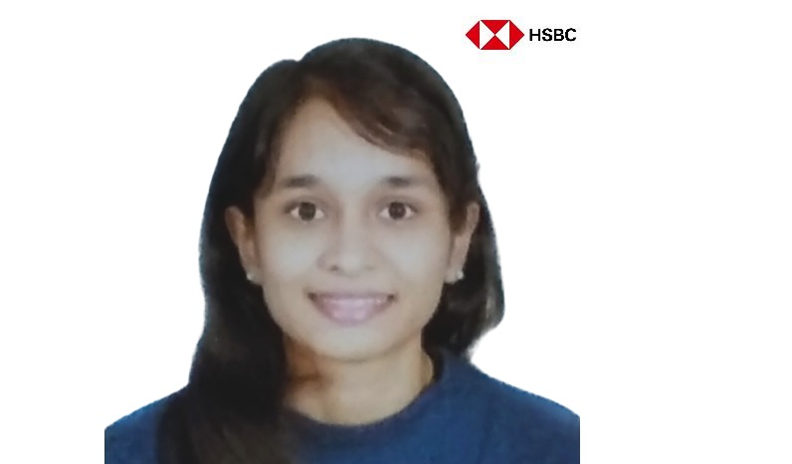
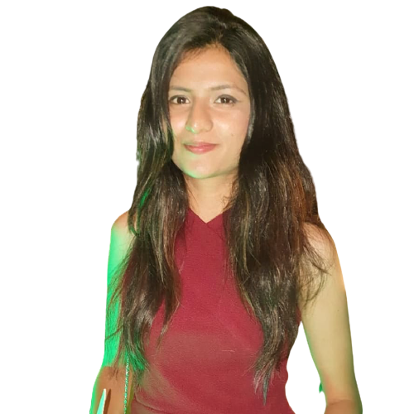
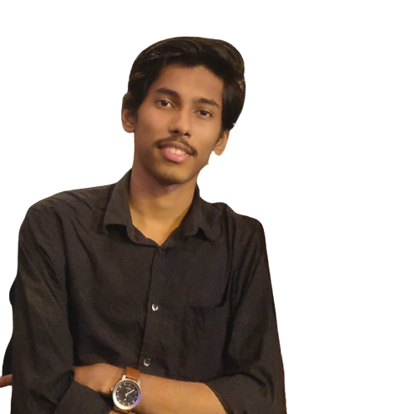
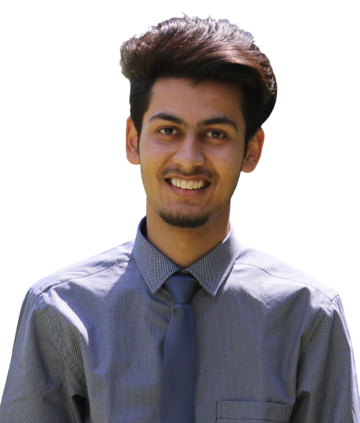
Team Members
Mansi Gupta Team lead
Pratik Patil
Ayush Saxena
Suhani Rathi
Neha Govekar
Vaibhav Narkhede
Sahil Sharma

Slide 3
FEATURES
Be Yourself! Create a Profile for you.
You can always update your profile.
Send and Accept Friend Request to build your connections.
Personalized contact list for your ease.
Block a user.
Separate Interface for Admin to view information about all users and their activity.
Admin has privilege to disable and delete a user based on their activity .
High level login authentication using SHA.
Normalised database design to remove data redundancy.

Slide 4
Functional Diagram
Start
LOGIN
Register
(for normal user)
Fail
Success
Add details
NO
If Admin
YES
USER
ADMIN
View & search Friends
View users in system
Block and remove friends
View user activity
Maintain personal Contact List
Disable and delete user
Logout

Slide 5
LEARNING CONCEPTS
Technical Concepts
Modular approach taken to divide work into micro tasks and embed them in an individual function to make the code reusable.
Extensible approach in design to add new functionality with minimum changes to the working program.
MVC architecture with loose coupling to avoid more interdependency
Organized dependable and Collaborative approach for optimal solution
Managerial Insights gained
Arrange daily meets to track up the progress and setting upcoming goals.
Value based prioritization in process of building the product
Knowledge management, and team collaboration to avoid delays in achieving goals.

Slide 6
TOOLS & COLLABORATION
Tools For Task and Project Management
Spring tool suite for developing Dynamic Java web application .
Derby Database
Apache Tomcat Server.
GitHub for version control and source code management.
https://github.com/pratik8798/Contacts-And-Networking-Application
Tools For General Collaboration
Zoom meetings to brainstorm about the problem statement and formulate a optimal solution.
Zoom meeting everyday to discuss about the daily agenda and track the progress done daily.
Paired Programming to deal with errors and resolving it on the go.

Slide 7
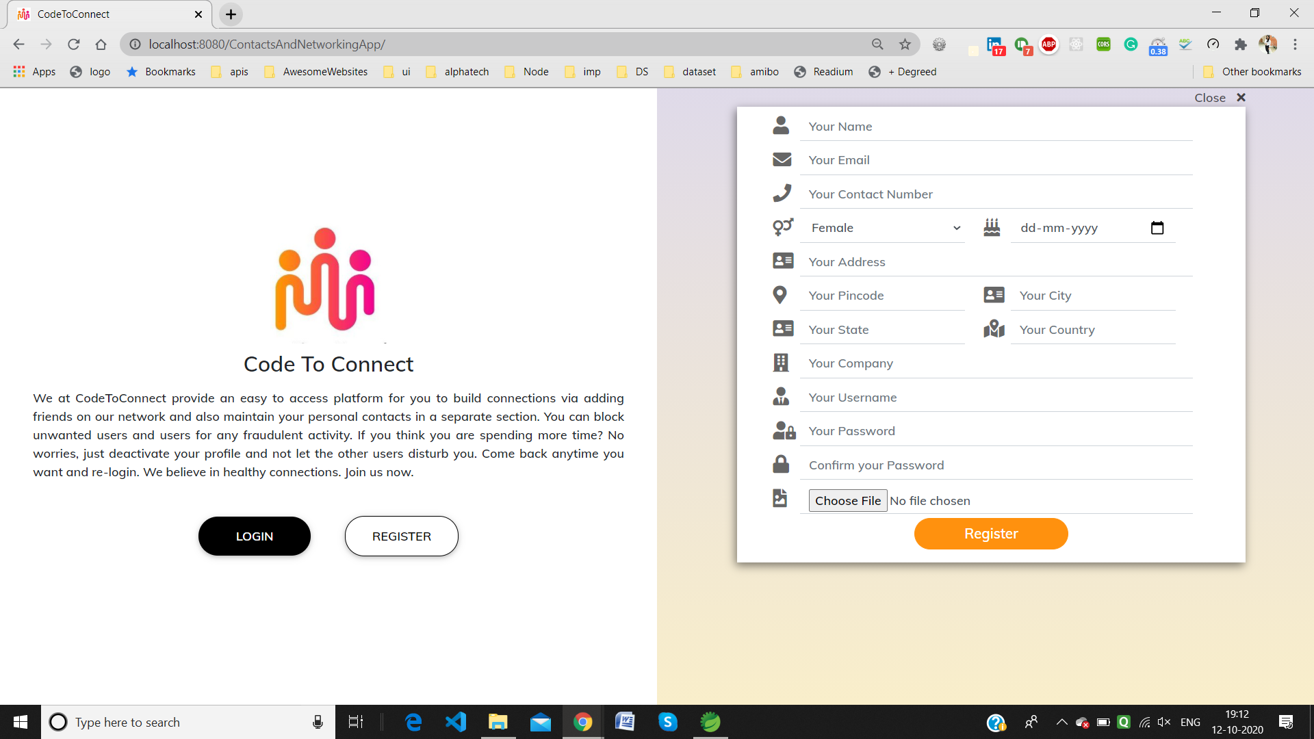
User Interface
Registration and Login
To see the entire User Interface glance through the document below

Slide 8
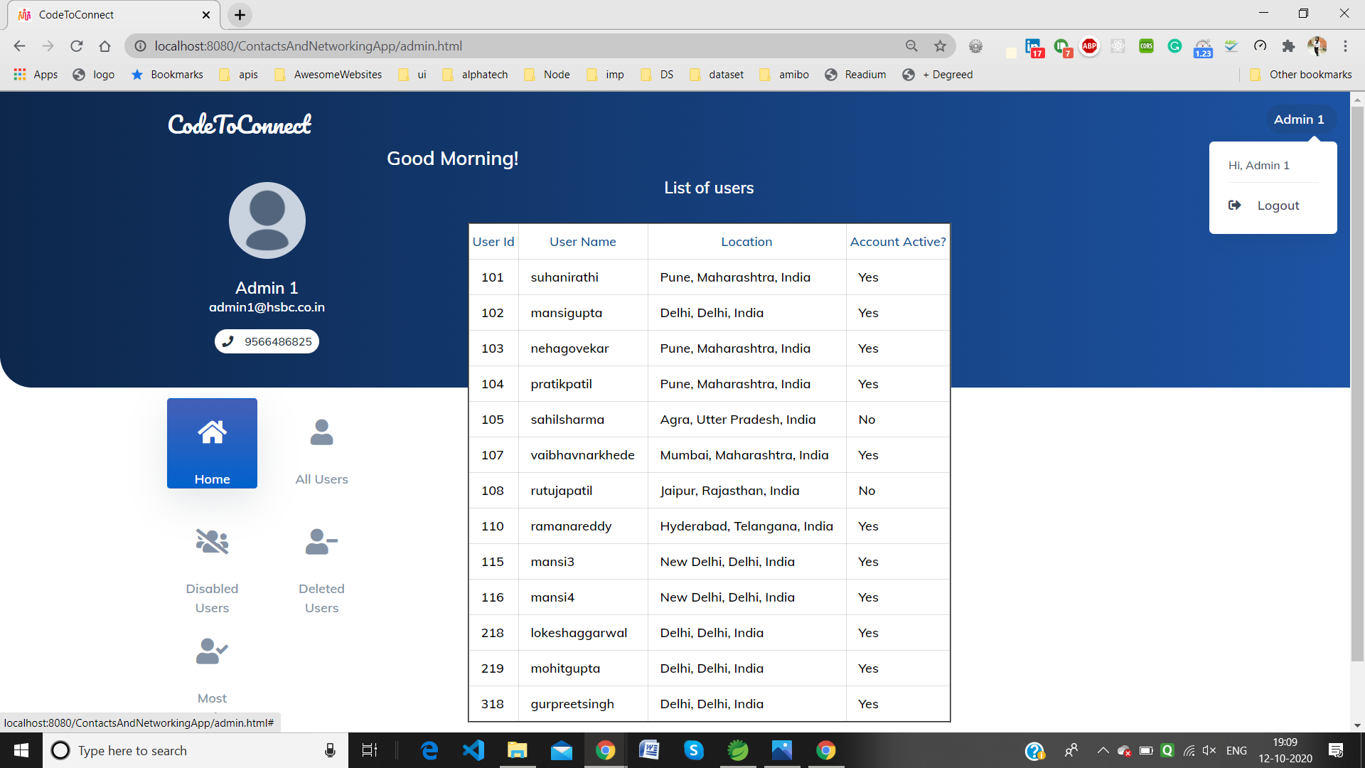
ADMIN DASHBOARD
To see the entire Admin Interface glance through the document below

